Slide 1

DAY 1 | Lotty (@lottybrand) | Diego
1.00pm | Introduce Open Science part 1
1.30pm | Q&A / Discussion - Plan S | Q&A / Discussion – Plan S
1.45pm | Introduce Open Science part 2
2.15pm | Q&A / Discussion – Preregistration TEA & COFFEE | Q&A / Discussion – Preregistration TEA & COFFEE
2.30pm | Further points on preregistration
3.00pm |  | Introduce the dataset and the question for Day 2
3.15pm | Go over preregistration template
3.15pm – 4.00pm | Preregistration exercise | Preregistration exercise
4.00pm | Q&A about preregistration, discuss any difficulties | Q&A about preregistration, discuss any difficulties
4.15pm | Introduce Github/ Version control | Introduce Github/ Version control
4.30pm | Download Git on machines | Download Git on machines

Slide 2
DAY 2 | Lotty | Diego
1.00pm |  | Project structure, version control p. I
2.00pm | Q&A / Discussion | Q&A / Discussion
2.15pm |  | Version control p. II, GitHub
3.15pm | Q&A / Discussion | Q&A / Discussion
3.30pm |  | Using remake
4.00pm |  | Writing a reproducible report
4.30pm | Q&A / Discussion | Q&A / Discussion
4.45pm | Wrap-up | Wrap-up

Slide 3
What is Open Science?
Publishing in Open Access Journals
Sharing your data with your publication
Sharing your analysis script and your data with your publication
Practicing transparent and reproducible research from the beginning of the research project to the end (preregistration, version control, well documented data collection procedures, data processing and analysis scripts, preprints, open peer-review, and making all of this openly available alongside your manuscript and data)
Notes:
Lots of different things at lots of different levels: 1) The publishing system, majority of papers and journals at the moment are not open access, in that you have to subscript to them or pay a fee to read individual articles (most of us are at universities that pay huge subscriptions)
2) Including your data with your publication, so the data is openly available for others to use/inspect/etc. Arguments from ethical standpoints, relating to philosophical and societal arguments about whether data is a commodity and should be bought and sold or not etc
3) Another step is including not just data but analysis scripts with your publication – getting into more open and transparent research practices, stemming from replication crisis
4) Widest, latest, broadest, most open(?) stance is practicing transparent and reproducible science practices from the get-go.

Slide 4
Scientific Publishing
Most of us can only access journal articles through your university subscription
Ethical arguments against this: tax payers pay for research, but can’t access the research themselves
Also: researchers outside of wealthy academic institutions can’t afford subscriptions, and other professionals need the info (e.g. doctors!)
Academic publishers are hugely profiteering, wider profit margins than Google and Shell

Slide 5
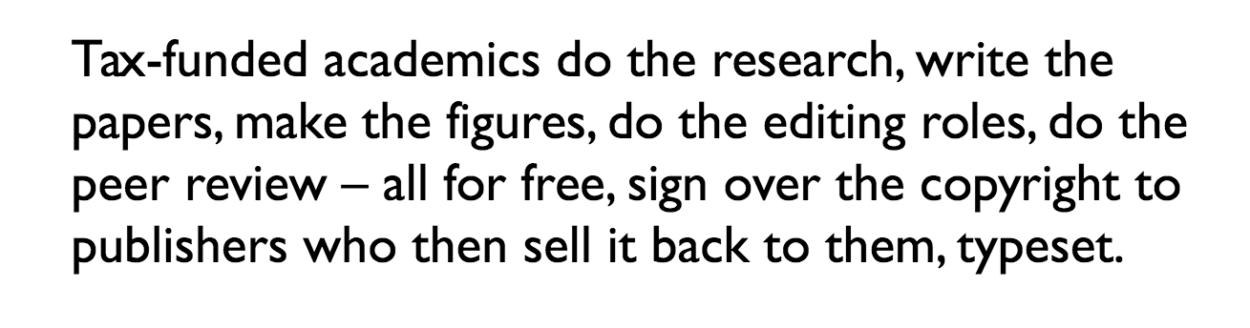
Huh?

Slide 6
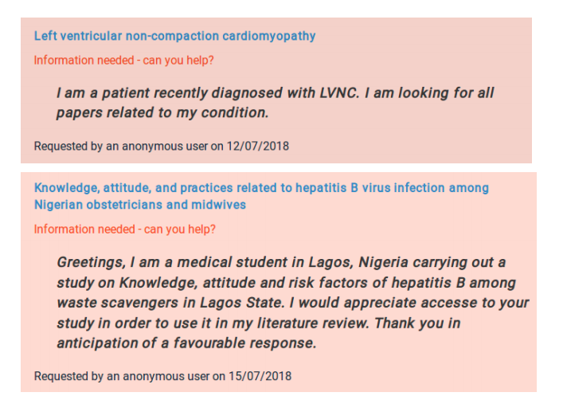
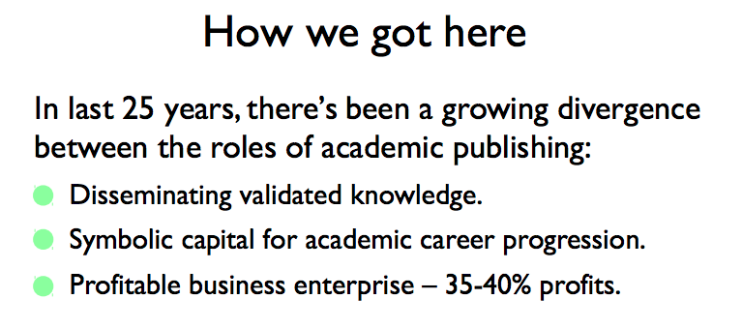
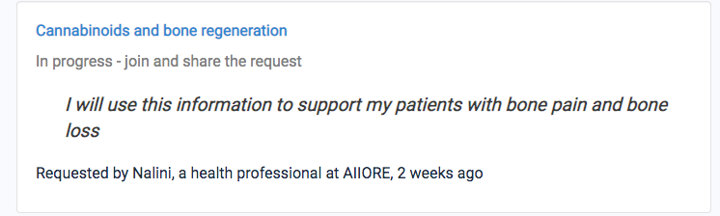

Slide 7
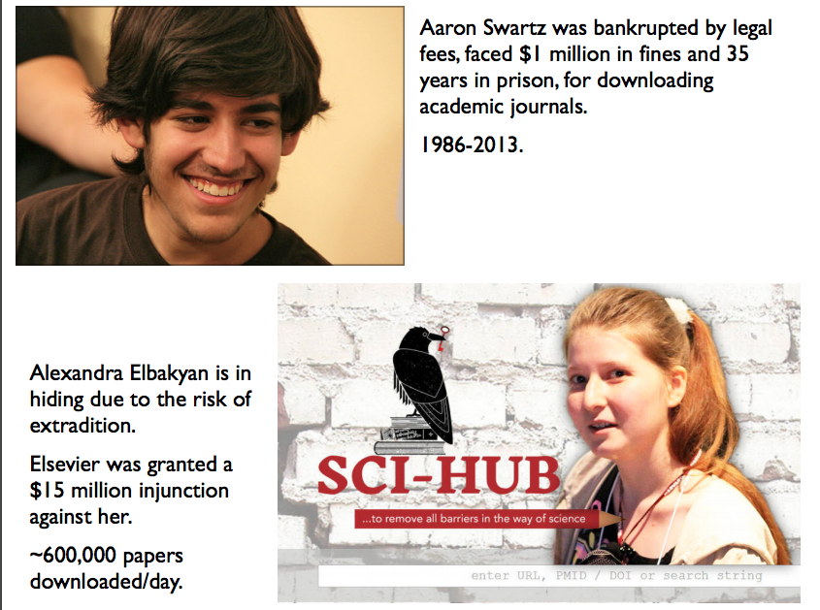
Notes:
Full-on dystopian horror show in my opinion

Slide 8
Open Access Journals
Some subset of regular journals, RSOS, Nature Communications, etc – charge APCs
Some are ‘free’- Ecology & Evolution, PeerJ, PLOS Biology – see https://en.m.Wikipedia.org/wiki/List_of_open-access_journals
Some are entirely free, online only, voluntarily run – see Meta-Psychology Journal (OJS)
Notes:
Transparency in Ecology and Evolution community

Slide 9
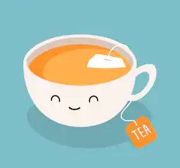
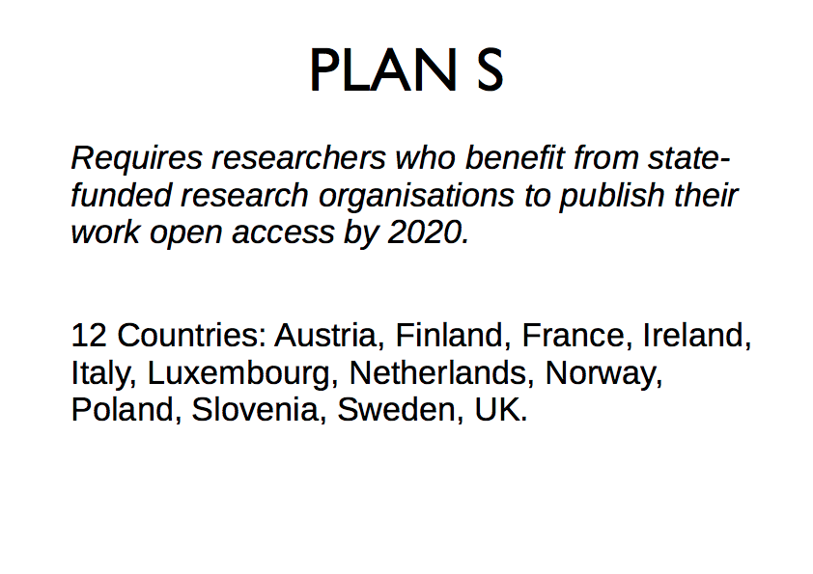
Plan S- discuss
Notes:
Check symplectic rules
Check Plan S rules

Slide 10
Plan S - discuss
The AAAS, publisher of the journal Science, argued that Plan S "will not support high-quality peer-review, research publication and dissemination…
…would disrupt scholarly communications, be a disservice to researchers, and impinge academic freedom"
“potentially undermines the whole research publishing system” – Springer Nature
'If you think that information should be free of charge, go to Wikipedia’ – Spokesperson for Elsevier (Tom Reller)
head of the Scientific Information Provision at the Max Planck Digital Library, told The Scientist that "This will put increased pressure on publishers and on the consciousness of individual researchers that an ecosystem change is possible ..”
Notes:
Check symplectic rules

Slide 11
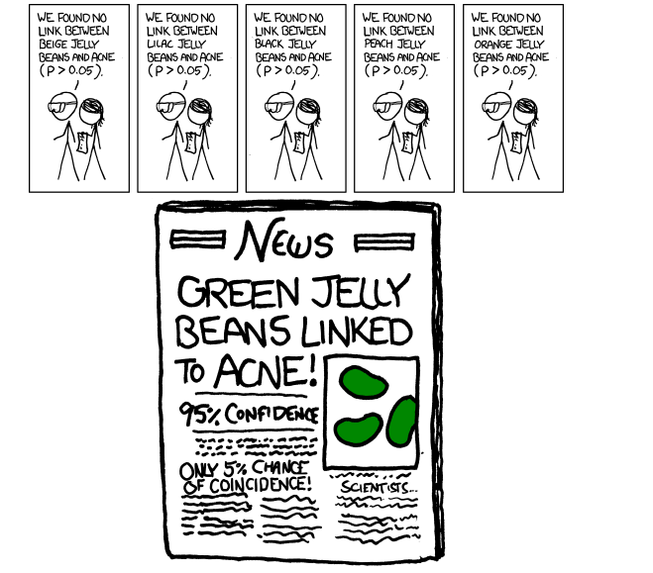
Share your analysis script
P-hacking
HARKing
Publication bias
distorted literature
Wasted research time & money
Replication crisis

Slide 12
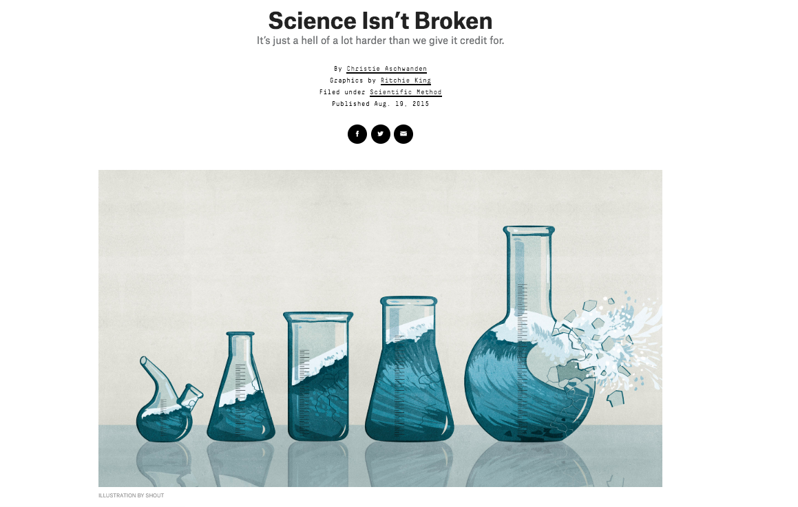
Replication crisis
It ‘began’ in Psychology but the problems are science-wide…
Notes:
100 studies from three high impact psychology journals from 2008 (psych sci, journal of social psy, journal of cognitive psy)
Only 36 replicated original reported effect (used same materials, contacted previous authors etc etc)
Not only that, effect sizes much smaller, and “funnel plot” of p-values of originals versus replicated
-many more reports since of “classic” or “popular psychology” findings, e.g. power pose, ego-depletion – media headlines. Bad example, seems must’ve known…
Controversy about “shaming” researchers and “stats police” …science self-correcting, now social media allows this open conversation and critique of work, data can be reanalysed etc- a good thing. Otherside is labs encouraging students to p-hack, not fraudulently, but sloppily. PhD students basing research on bogus literature- assuming they’re bad scientists when they don’t replicate the effect
What is the problem? Publication bias, p-hacking, HARKing…
How do we fix it? Surely not all scientists are liars..
One thing is open science… another is ‘metascience’ modelling the process of science itself – fave paper. Playing with parameters of false positive rates, replication rates, publication rates etc etc replication is good in separating true hypotheses from false, esp when negative replications are published…
Natural selection of bad science… can be ACCIDENT… assumes scientists have good intentions

Slide 13
Meta-science
Main message: NOT about bad scientists, but bad incentives and a flawed system
Through the variation, selection, and reproduction of scientific practices…
A lot of bad practice is maintained by accident, unconsciously following norms...
Notes:
Like most of the world’s problems, most people are just trying their best to survive in a flawed system.
A rare few individuals might be “trying to play the system” and purposely fudging data, but they are being found out, and this is going to be much more difficult with reproducible science practices.

Slide 14
Reproducibility
Is my supervisor checking this?
Is the rest of the field checking this?
Now they can (and will)!
Preregistration and/or Registered Reports
Using R over SPSS/other point-click software
Version control and repositories
Pre-print archives
Open journals/data/scripts
(also, Twitter)

Slide 15
PREREGISTRATION – Discuss
Time-stamped, open record of your predictions, hypotheses and analysis plan

Slide 16
Preregistration
Stating predictions before data collection (we do this anyway, right?!)
Designed to prevents HARKing, p-hacking, other unconscious QRPs

Slide 17
Preregistration vs Registered Reports
Time-stamped, open record of your predictions, hypotheses and analysis plan
Usually (but not exclusively) before you collect your data
Is not linked to any particular journal
Peer-review is conducted on your intro, methods and analysis, before you collect the data
This is done with a specific journal who promises to publish your work as long as you follow that peer-reviewed plan

Slide 18
Why bother?
It speeds up your research
Freedom from too many degrees of freedom (and anxiety)
Confidence to explore
Gain reviewers’ trust
Be scoop-proof!
Improve the validity of science ..forever….

Slide 19
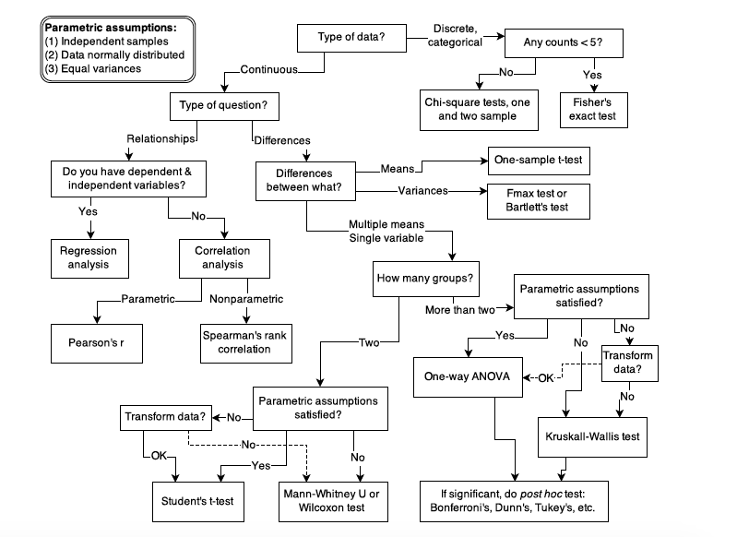
Speeds up your research!
Notes:
Have you ever been faced with a
large, complex dataset and instantly known the best way to analyse it, which parameters
to include, which random effects, how to clean and reshape the data, and the code to go
with it? Of course not- unless you’ve preregistered.
“I already plan my analysis before I collect the data….” That’s what I thought too. until you are forced to answer very detailed questions
about EXACTLY what you’re going to do, and, even better, write the analysis script and
run it with dummy data, I guarantee you have not thought of every tiny detail. Having not
preregistered anything during my PhD, I know all too well (as I’m sure most of you do)
the feeling of being faced with a dataset, and realising that not only did you overlook a
few seemingly minor things that constrain your analysis in pretty fundamental ways, but
there are also an overwhelming number of possibilities for how to analyse it to answer
your research question. Get all this out the way BEFORE see the data, make a few minor adjustments if needs be etc

Slide 20
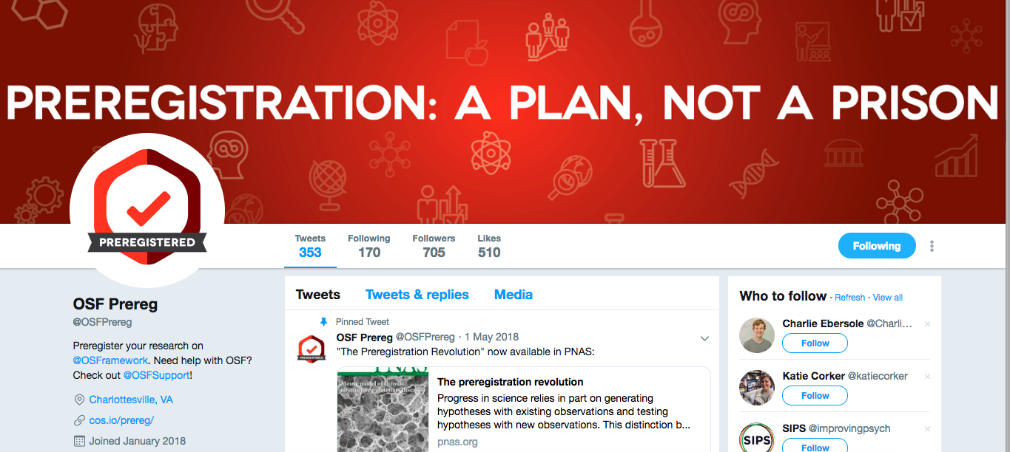
Freedom from degrees of freedom (and anxiety!)

Slide 21
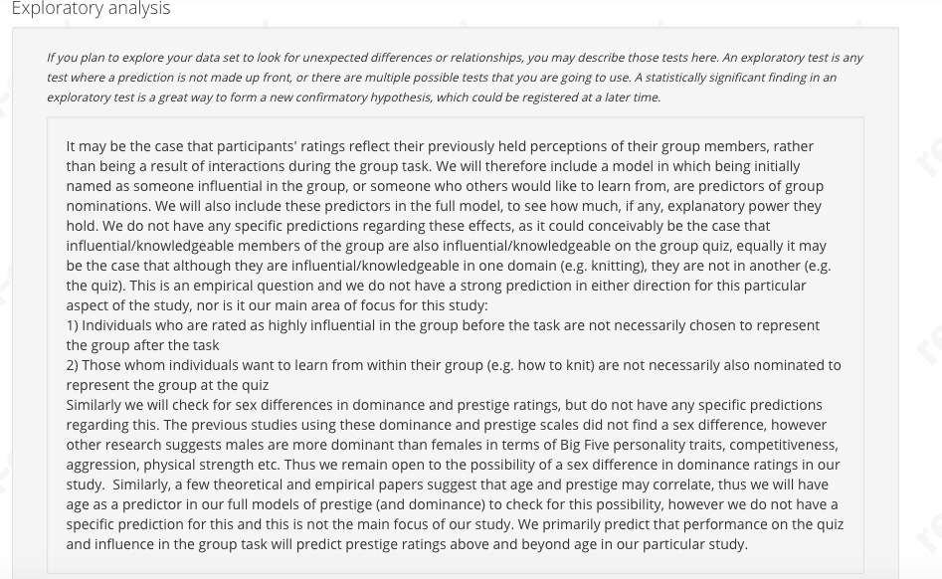
Confidence to Explore!

Slide 22
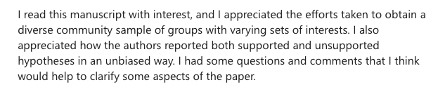
Gain reviewers’ trust!

Slide 23
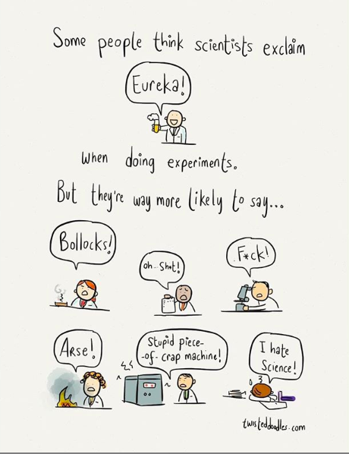
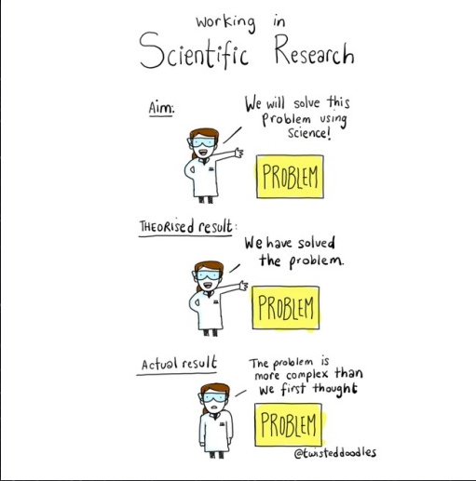
Improve validity and trust in science… forever!
Notes:
Wasted research hours on stuff that isn’t replicable
Focus on cumulative incremental findings, not black and white headline-grabbing science
Help with publication bias and more transparent, apriori based predictiosn and analysis…
Persuading the public to trust us…?!?!

Slide 24
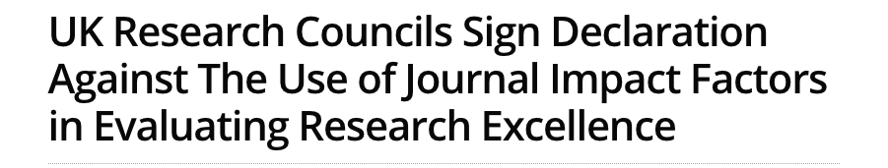
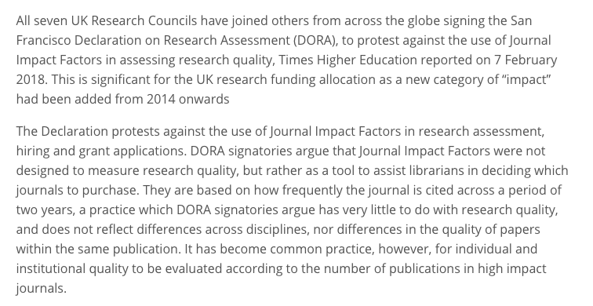
Let’s talk about impact…

Slide 25
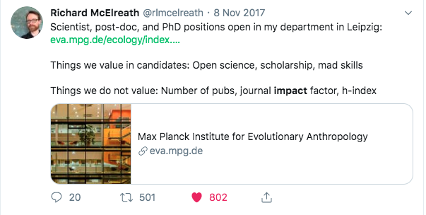
Wisdom, not impact
“Some people think that what I should be doing is producing Nature and Science papers. More than one colleague has specifically asked me which “Science/Nature projects” I have planned. That is not what Max Planck Departments are for. High-profile publications may arise, but they should be side effects. We demand wisdom, not professional impact.”
Richard McElreath, a director of the Max Planck Institute for Evolutionary Anthropology http://elevanth.org/blog/2018/09/02/golden_eggs/
Hiring decisions:
Notes:
My advice: You will come across people who do not endorse it, who say they endorse it but don’t practice it, or actively argue it is bad/waste of time.
They probably benefitted from the current/old system, and don’t see the appeal to change, don’t appreciate how destructive the current practices are for science/scientists and wider society. Worth highlighting how people find it makes research easier, more enjoyable, less stressful. More research on this will be coming out as Open Science gains more momentum. If you want to work with them, fine! If you don’t, find someone who is hiring based on open science practices….

Slide 26
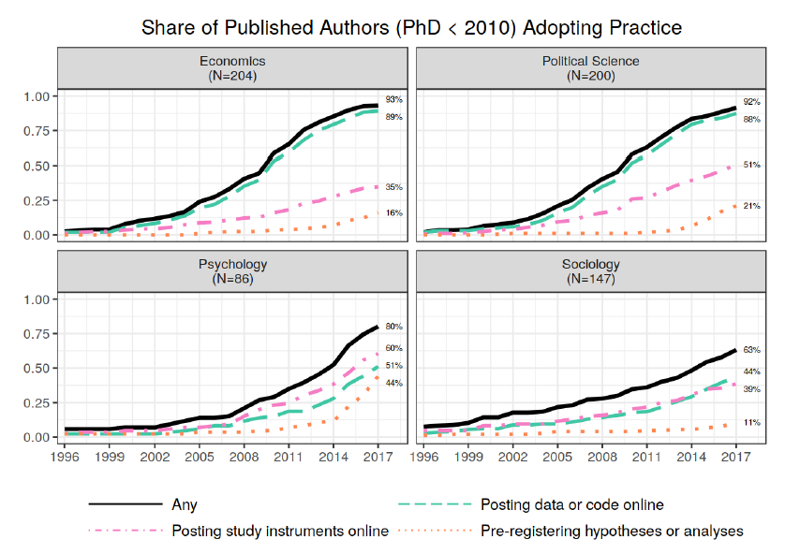
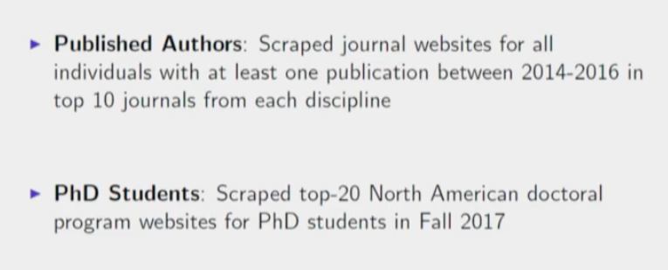
Is anyone actually doing it?
Pre-registered… obviously!
https://www.bitss.org/events/2018am/
Notes:
Find data on open science practices in ecology….

Slide 27
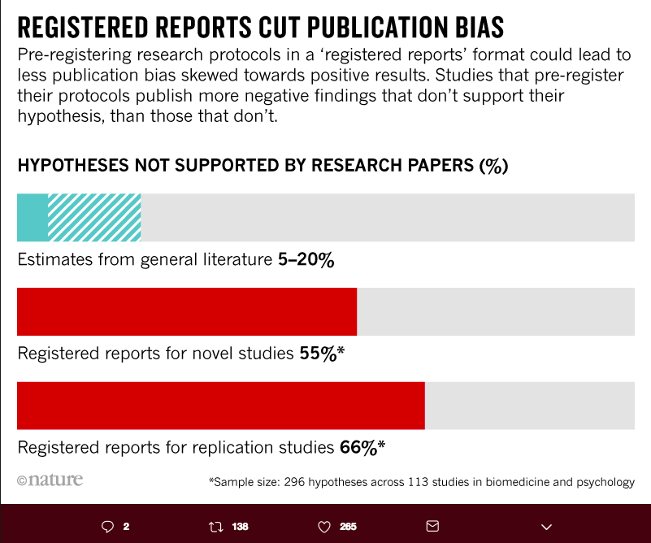
Is anyone actually doing it?
https://www.nature.com/articles/d41586-018-07118-1

Slide 28
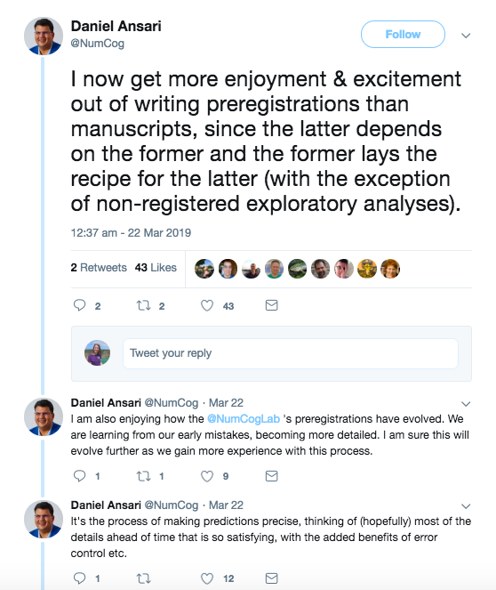
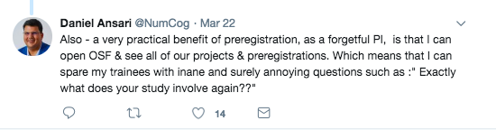
Is anyone doing it?

Slide 29
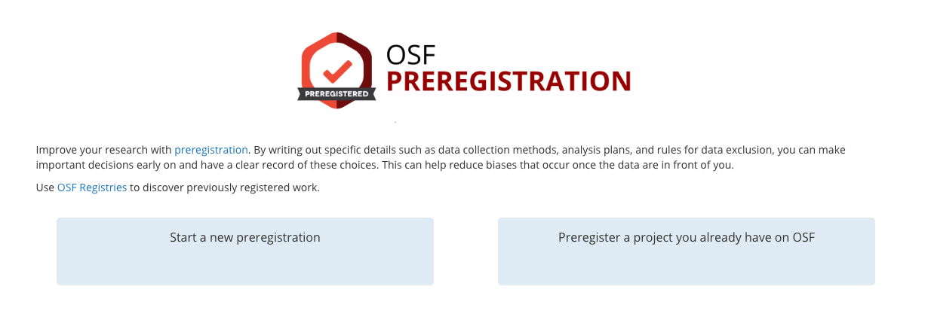
How do I do it?
https://psyarxiv.com/wte5z/ <- step by step slideshow
https://osf.io/prereg/
www.aspredicted.org
https://docs.google.com/document/d/1w_3DPN6c-evOfgHBfeVgN-huBwMRe3EJCzGFG9Tzs54/edit?usp=sharing <- full template

Slide 30
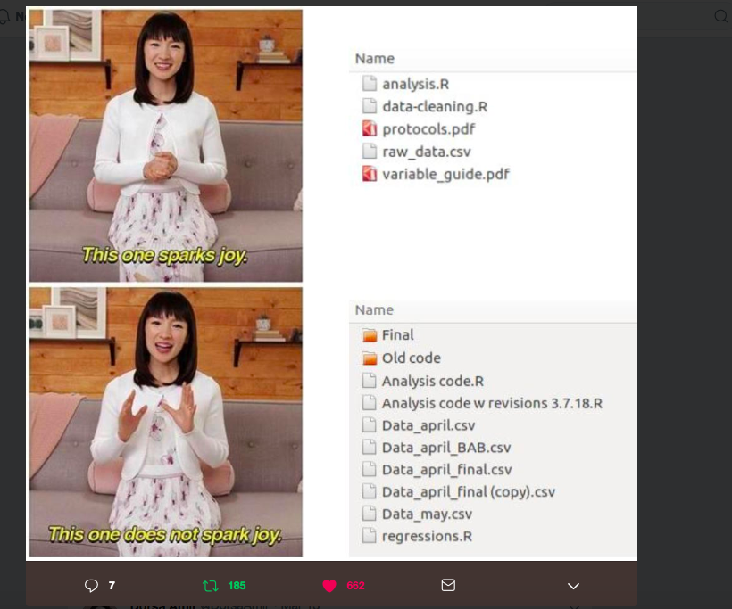
Version Control
Benefits your collaborators
Benefits other researchers doing similar work
Benefits FUTURE YOU

Slide 31
How do I do it?
GitHub
Can use desktop / Rstudio if command-line too confusing…
http://swcarpentry.github.io/git-novice/01-basics/index.html
http://swcarpentry.github.io/git-novice/guide/
http://nicercode.github.io/2014-02-13-UNSW/lessons/70-version-control/why.html

Slide 32
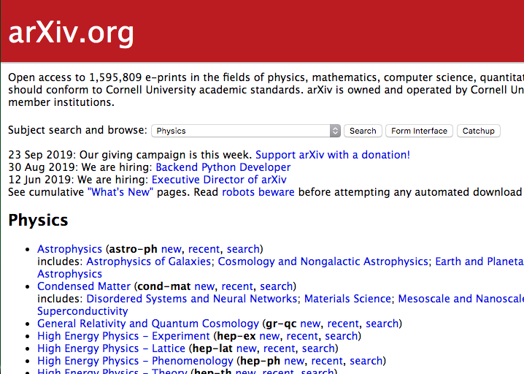
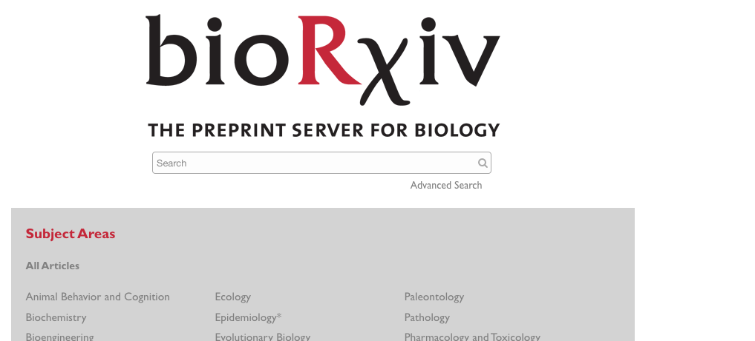
Preprints

Slide 33
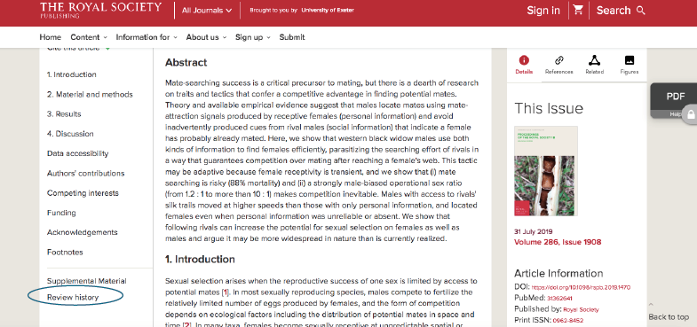
Open Review
Notes:
Debates around whether the review process should be open too

Slide 34
Sharing your data?
Should data be owned, bought, sold? Some argue no, as long as the data complies with ethics, is anonymized, was consented, should be open to all.
From a scientific perspective- sharing your data allows others to verify your conclusions, make use of it themselves, not have to repeat collect the same data – collaborate!

Slide 35
Scoop Proof!
You have a jaw-dropping unique idea- Preregister it!
Someone claims the same idea - point them to your time-stamped preregistration! If they claim they had the idea first, too bad, they should’ve preregistered it (or, you should’ve!)
If they preregistered at exactly the same time too, bond over this coincidence and turn the competition into collaboration
If they claim they genuinely didn’t see your preregistration (or you genuinely didn’t see theirs) this is just bad luck and cannot be avoided just like the real life world of people having simultaneous research ideas…. Preregistration doesn’t make this any more likely
Notes:
Talk about this if anyone asks/ if it comes up in convo

Slide 36
Other resources:
Transparency in Ecology and Evolution community: http://www.ecoevotransparency.org/
List of journals accepting Registered Reports: https://cos.io/rr/
Metascience conference: https://www.metascience2019.org/program/
Open Sci Conf: https://www.aimos2019conference.com/program
Open Science Workshop: https://psyarxiv.com/wte5z/
https://doi.org/10.1098/rsos.160384 The Natural Selection of Bad Science (Smaldino & McElreath 2016)
https://journals.sagepub.com/doi/full/10.1177/1745691618767878 – Open Science is Liberating and can foster Creativity (Frankenhuis & Nettle 2018)
https://www.pnas.org/content/115/11/2600 The Preregistration Revolution (Nosek et al 2018)
OSF https://osf.io/
Preprints https://www.biorxiv.org/
Publons https://publons.com/researcher/1248054/charlotte-brand/
Access Lab: https://fo.am/activities/accesslab/
Julia Rohrer’s open science slides https://osf.io/e4fja
Open science course course https://osf.io/87arq/
Munafo manifesto https://www.nature.com/articles/s41562-016-0021
Dance of the p values https://www.youtube.com/watch?v=5OL1RqHrZQ8
APC’s http://thetaper.library.virginia.edu/big%20deal/apcs/serials%20crisis/2019/10/07/weekly-big-deal-longread-article-processing-charge-hyperinflation-and-price-insensitivity-an-open-access-sequel-to-the-serials-crisis.html

Slide 37
Other resources… contact me for more! @lottybrand
https://force2019.sched.com/2019-10-16/overview Force2019
https://twitter.com/curatescience/status/1183454160068530180 Curate Science
https://www.norrag.org/democratising-knowledge-a-report-on-the-scholarly-publisher-elsevier-by-dr-jonathan-tennant/ A report on Elsevier
https://peerj.com/preprints/27638.pdf research into use of impact factors
https://osf.io/854zr/ Positive results rate in psychology: registered reports compared to conventional literature (Schijen, Scheel & Lakens 2019)
http://www.talyarkoni.org/blog/2018/10/02/no-its-not-the-incentives-its-you/ It’s Not the Incentives, it’s You
Plea for positivity and preregistration https://lottybrand.wordpress.com/2018/10/05/a-postdocs-plea-for-positivity-preregistration/
refuse Elsevier: https://www.talyarkoni.org/blog/2016/12/12/why-i-still-wont-review-for-or-publish-with-elsevier-and-think-you-shouldnt-either/
Universities ditch Elsevier: https://www.editage.com/insights/norway-joins-the-ranks-of-germany-and-sweden-cancels-subscription-with-elsevier, 2) https://scholarlykitchen.sspnet.org/2019/05/06/the-university-of-california-and-elsevier-an-interview-with-jeff-mackie-mason/
Profiteering publishers: https://www.theguardian.com/science/2017/jun/27/profitable-business-scientific-publishing-bad-for-science
https://www.theguardian.com/commentisfree/2019/mar/04/the-guardian-view-on-academic-publishing-disastrous-capitalism
Aaron Swartz https://en.wikipedia.org/wiki/Aaron_Swartz

Slide 38
